Slide 1
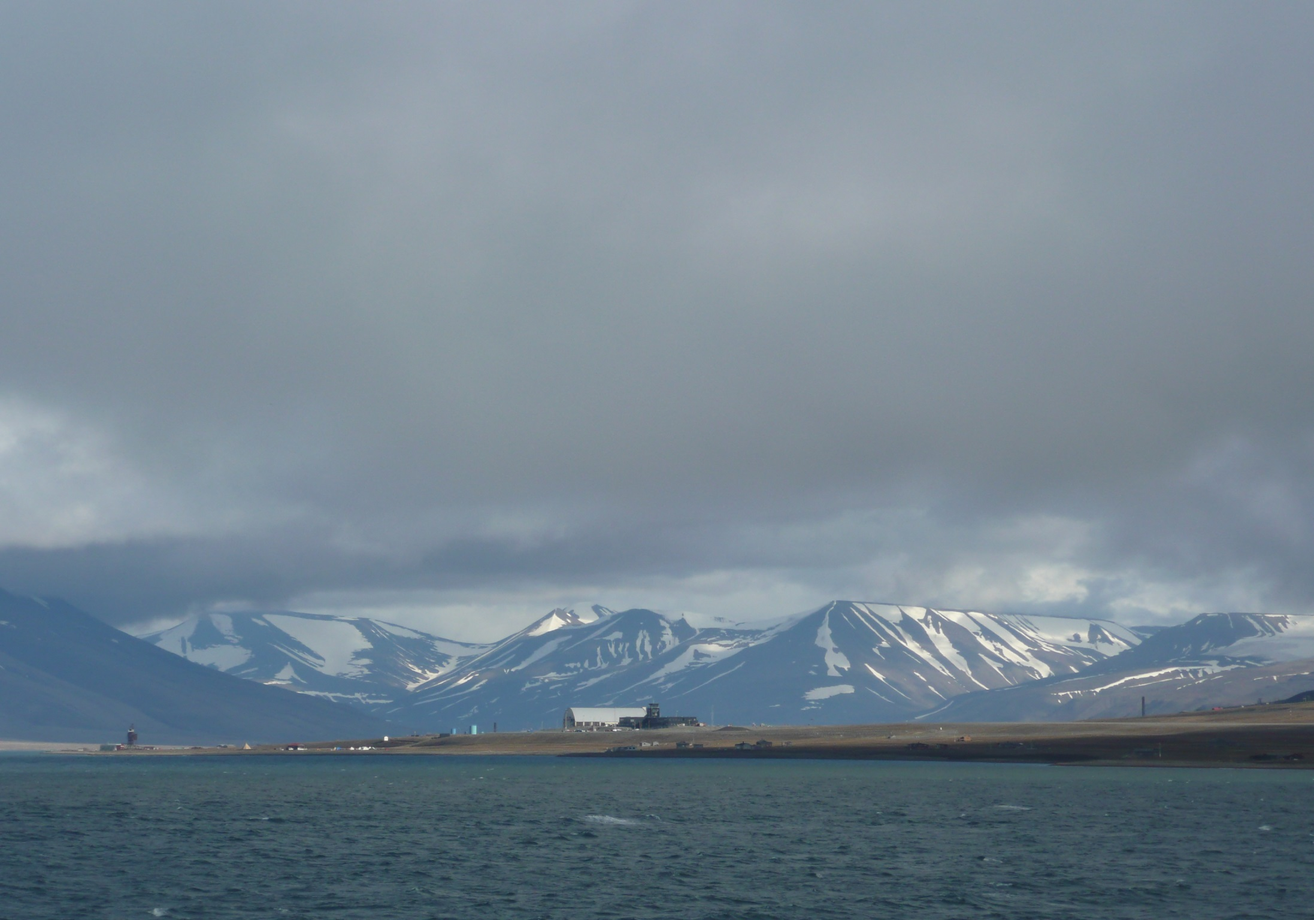

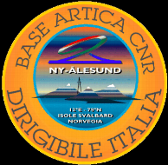

The Kongsfjorden as an integrated multidisciplinary system
Leonardo Langone
CNR-ISMAR, Bologna
leonardo.langone@ismar.cnr.it

Slide 2
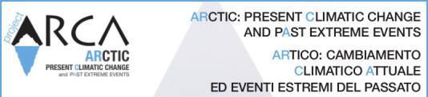
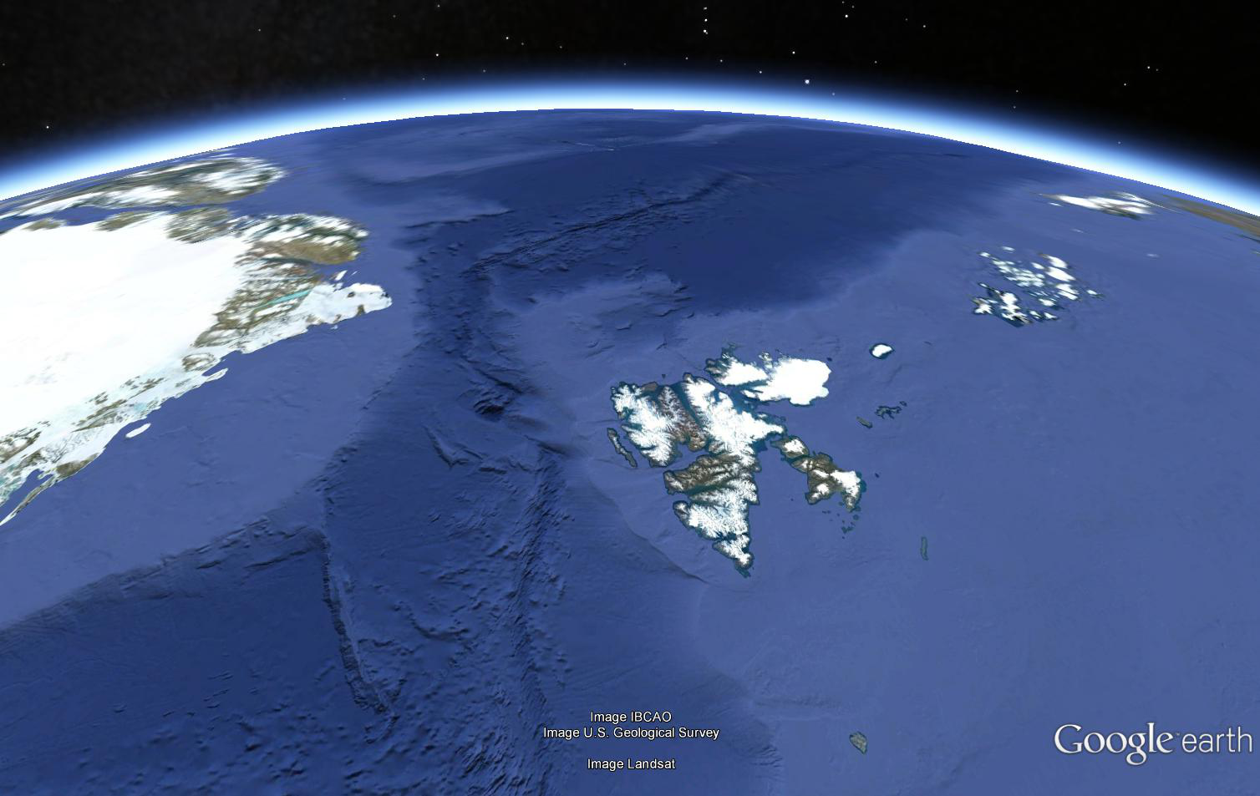
Project structure
WP1 - The integrated atmosphere-hydrosphere-cryosphere system
WP2 - Evolution and Dynamics of the glacial cap and outlet glaciers in Greenland
WP3 - Reconstruction of extreme meltwater events
WP4 - Conceptual model and distributed system for the management, use and dissemination of data
Arctic Ocean
Svalbard
Greenland
Kongsfjorden
Stofjorden
Atlantic Ocean
Barents Sea

Slide 3
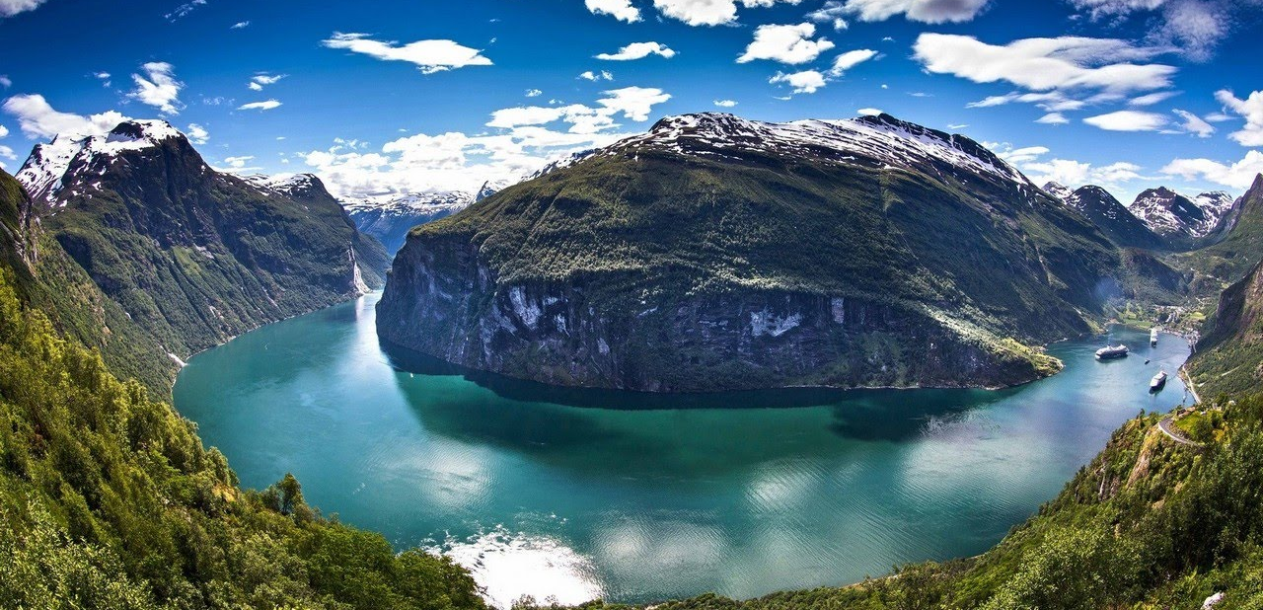
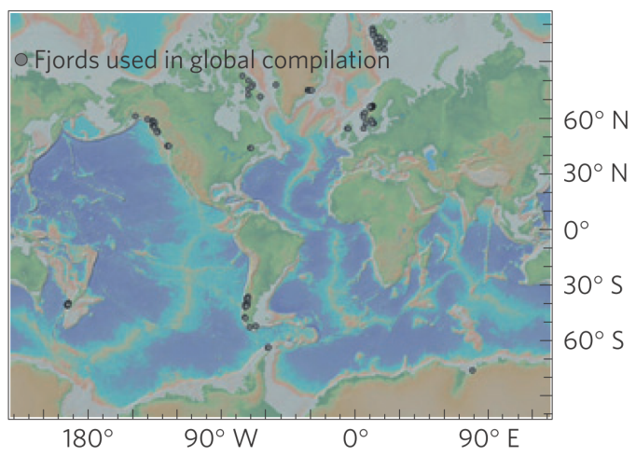
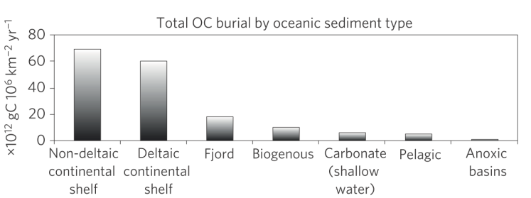
Fjords
Shape and origin
Most distributed at high latitudes
Ampliﬁcation of the climate change in the Arctic Ocean, but fjords even more sensible
Only 0.1% of the world's ocean surface but account for 11% of annual OC burial
Smith et al., 2015
Notes:
Fjords are long, deep and narrow inlets, often characterized by the presence of one or more sills. They were formed during glacial periods from the erosion of advancing glaciers in the major valleys near the coast
Many fjords on the coasts of north Europe, N and S America or New Zealand. Norway coastline >90% by fjords
Latest climate projections in the IPCC report indicate a polar ampliﬁcation of the climate change in the Arctic Ocean, but fjords are potentially even more vulnerable to impacts of the climate change because the interactions between land - glacial ice - sea ice - ocean - atmosphere are stronger, including also human activities
Climatic change impacts fjords by altering physical processes driving biological productivity, including changes in fresh water and suspended sediment inputs, coastal currents, light penetration through the water column, nutrient and DO concentrations

Slide 4
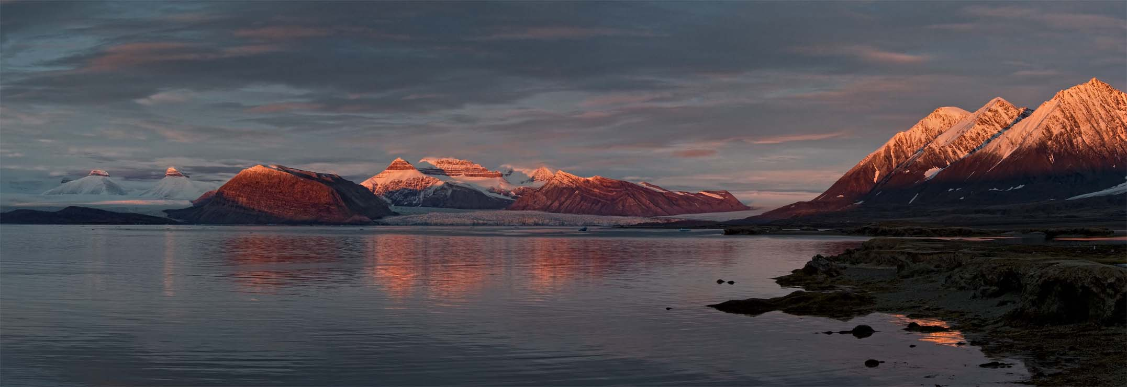
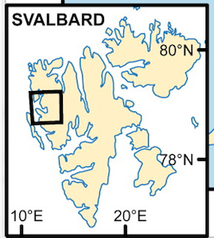
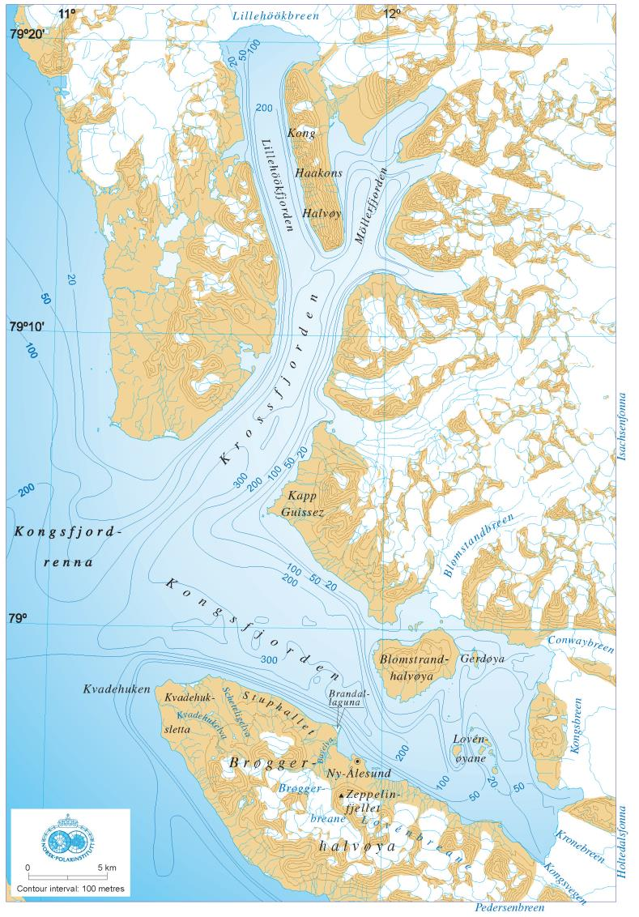
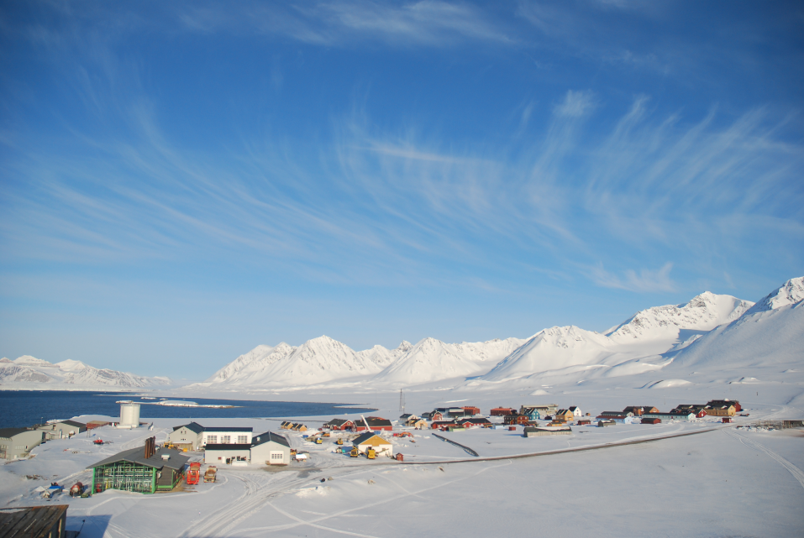
Kongsfjorden
- NW Spitsbergen Island (Svalbard)
- ca. 20 km long, 4-10 km wide
- outer fjord > 200 m deep - sill - shallower inner part (< 100 m deep).
Ny-Ålesund
Ny-Ålesund research centre
11 research stations in Ny-Ålesund
research projects and monitoring activities all year round
coordinated by NySMAC (Ny-Ålesund Science Manager Committee)

Slide 5
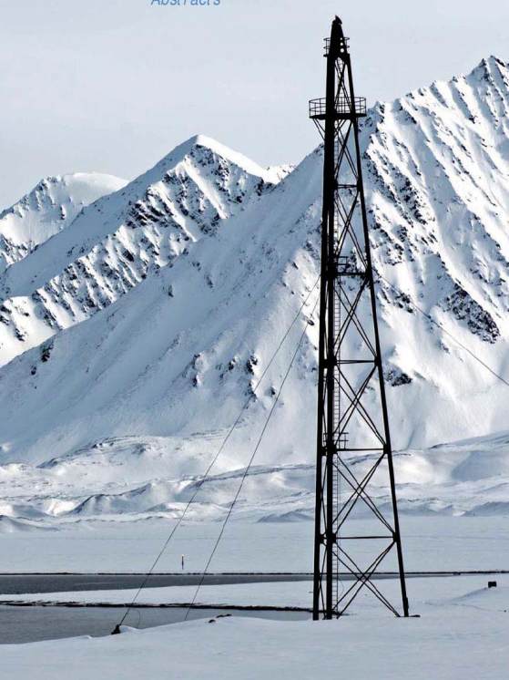
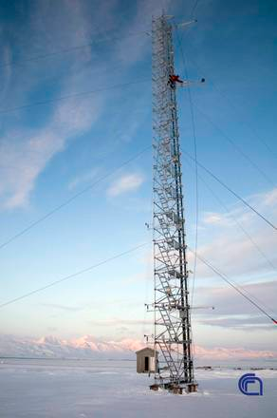
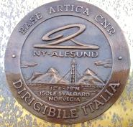
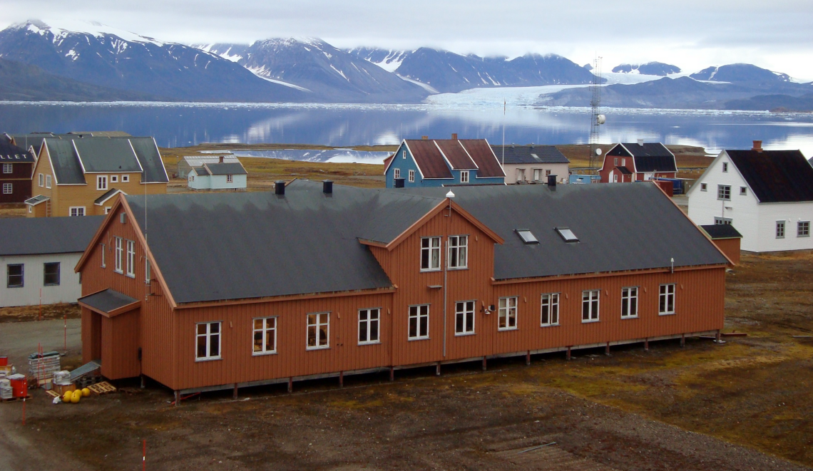
Base Dirigibile Italia
Managed by CNR, surface 330 m² with offices and labs, up to 7 researchers
Open all year round
Researches on atmospheric chemistry and physics; marine biology; physics of the high atmosphere; technological research, geology and geophysics; glaciology and permafrost; paleoclimate; oceanography and limnology; terrestrial ecosystems; human impact on the environment, human biology and medicine.
From 2009-10, setup of 3 multidisciplinary observation platforms :
Amundsen-Nobile Climate Change Tower (CCT),
Aerosol and Gruvebadet interface processes lab (GVB)
Oceanographic mooring MDI in the Kongsfjorden.

Slide 6
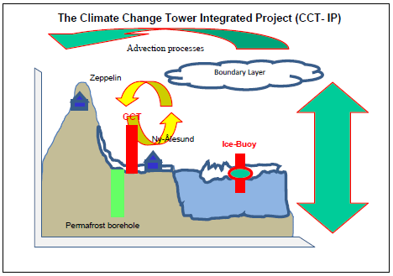
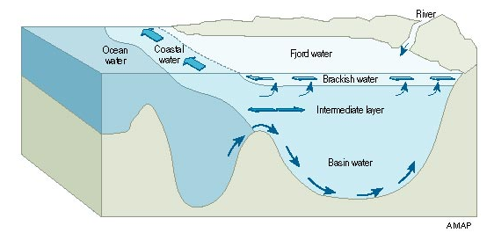
Integrated measurements at the main interfaces of the fjord
fjord
Atmosphere
Sediment
Ocean
Sea ice
Glacier
Land
Main parts of the system
Fjord
Glaciers
Sea ice
Ocean
Land
Atmosphere
Sediment
Flux measurements
Water
Salt
Heat
Dissolved and
Particulate matter
Conceptual models
Glacier
Atmosphere
Sea ice
Permafrost
Sediment
Pore water

Slide 7
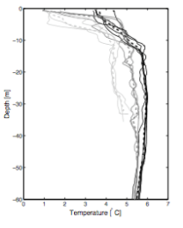
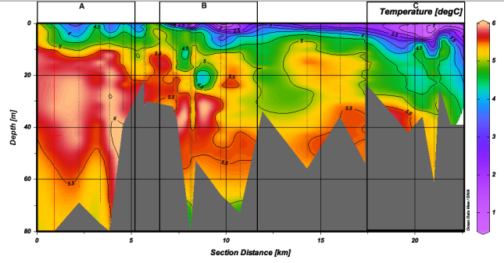
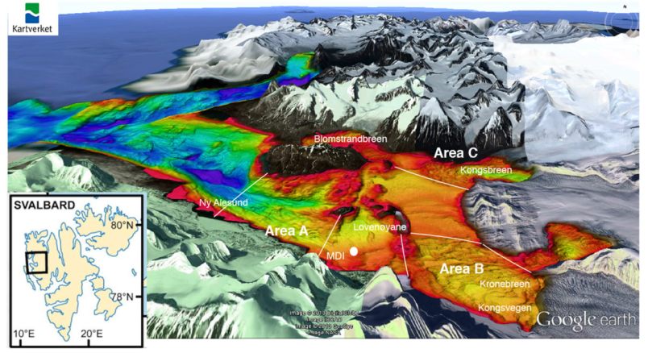
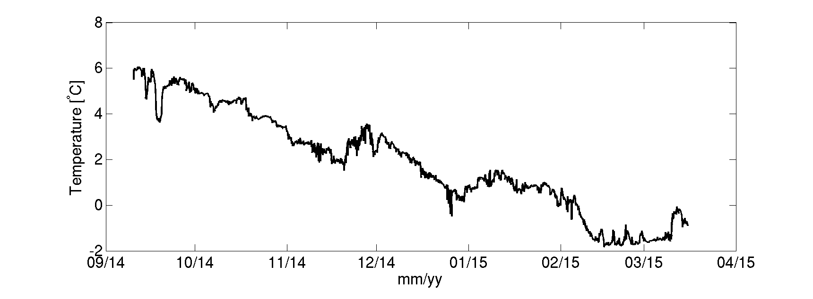
Seawater properties and Ocean Heat Content (OHC)
The contribution of heat from the ocean at the interface between the fjord water and tidewater glaciers has been suggested as a possible trigger that destabilize the glacier front.
The OHC does not depend only on temperature but also on the volume of water interacting with the ice front.
Based on bathymetric maps and CTD casts, OHC calculated for September 2014 → the heat loss in the innermost fjord was consistent with large ice melting.
Aliani et al., 2016 a & b
OC flux (g m⁻² y⁻¹)
On the contrary, in winter 2014 no warm input was found and ocean heat was adverse for ice melting.

Slide 8
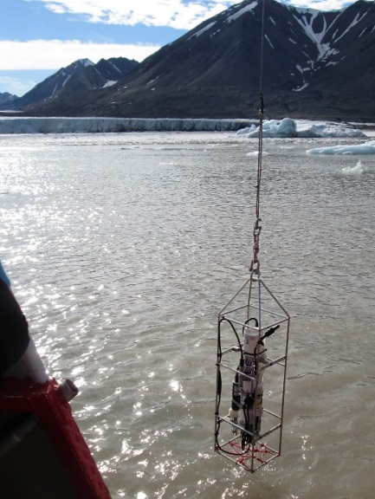
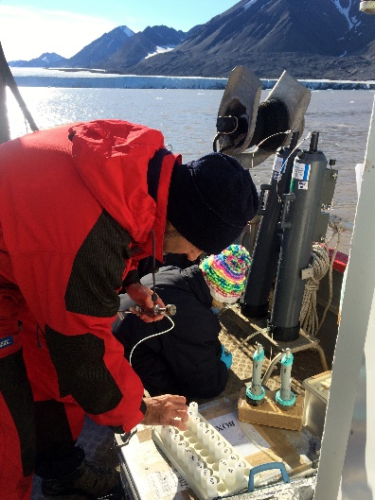
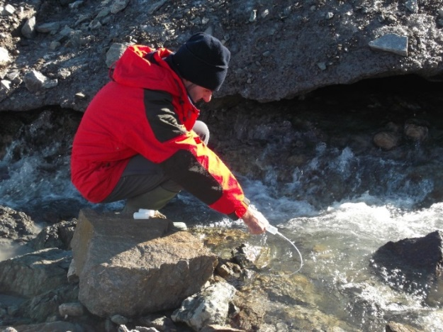
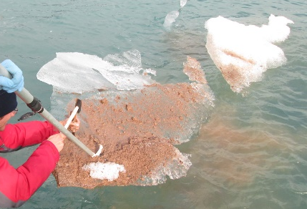
Carbonate chemistry in the fjord
In summer 2015, found high surface water pH values in Kongsfjorden (up to 8.6)
To maintain such a high value, pH of freshwater inputs discharging into the fjord must be very alkaline
In the longer term, when the meltwater discharge will decline, pH will decrease very rapidly, theoretically reaching a tipping point
Necessary specific experiments to follow the temporal trend of pH and alkalinity
Fieldwork : 21 July – 18 August 2016, peak of melting season
Cantoni & coworkers

Slide 9
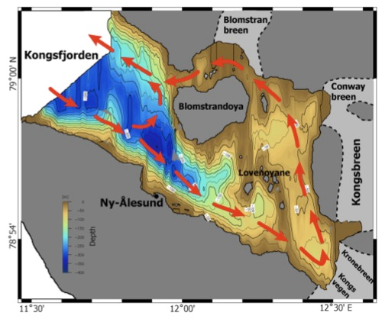
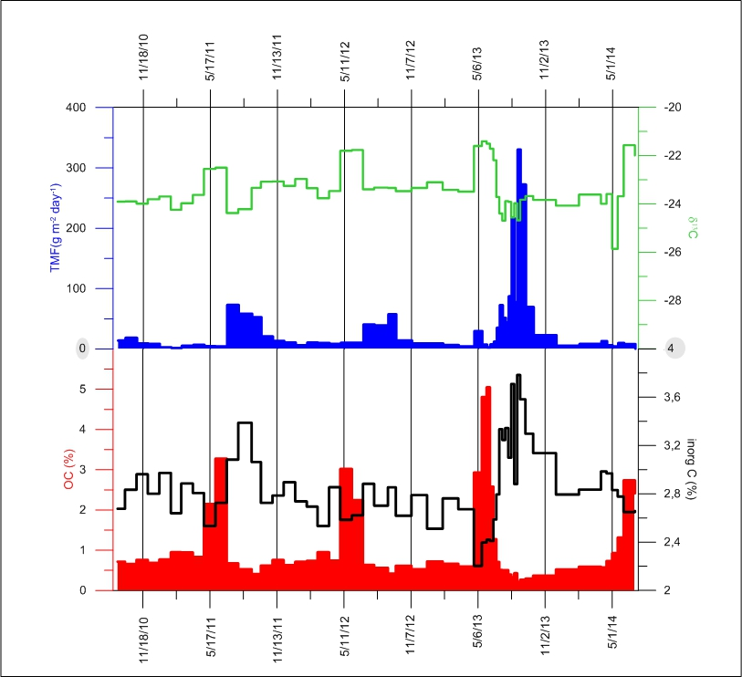
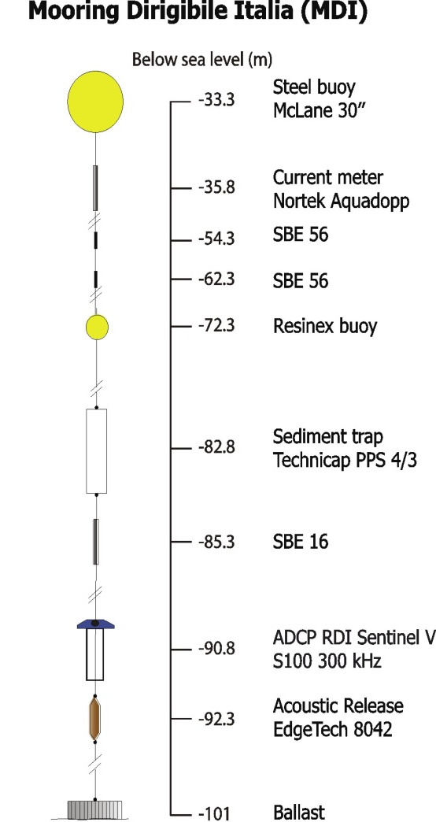
Particle fluxes in the Kongsfjorden
Mooring MDI since 2010 in Kongsfjorden
Results from the time series of particle fluxes and composition and physical properties of water massess
Mooring MDI
Avg. TMF, ca. 20 g m⁻² d⁻¹ (7 to 100 g m⁻² d⁻¹ in winter and summer, respectively)
%OC peak in spring-early summer by phytoplankton bloom (less negative δ¹³C)
TMF peaks in summer by glacier melting and surface runoff (turbid waters)
High detrital carbonates (20-30%)
High interannual variability (in 2013, TMF peak ca. 8 times higher than remaining years)
D’Angelo et al., 2016

Slide 10
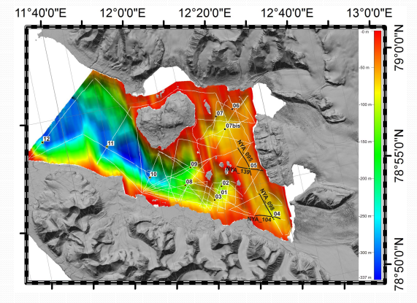
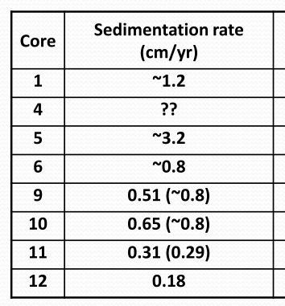
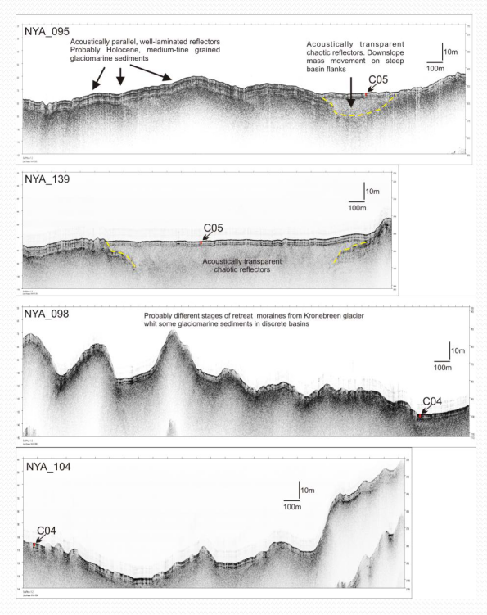
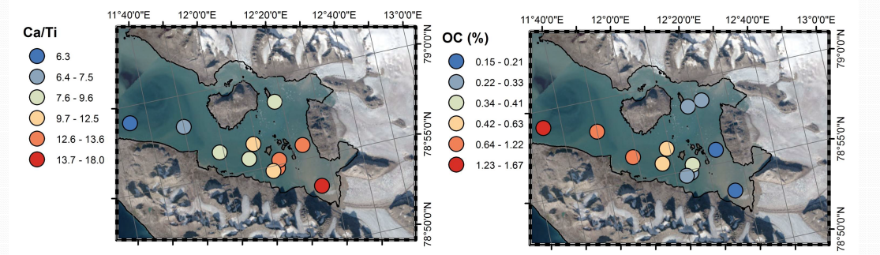
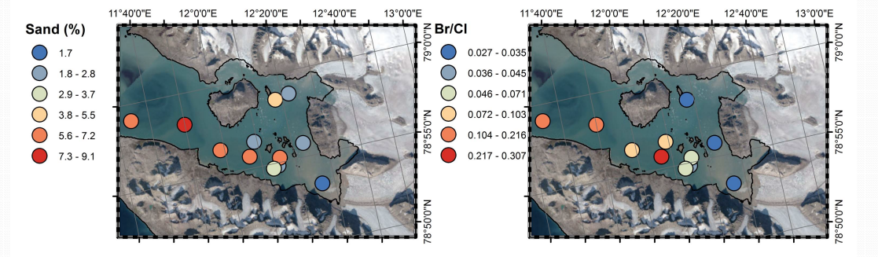
Modern sediment distribution and composition
Sedimentation rate decreases with increasing distance from glacier termini (Kronebreen and Kongsvegen)
The geochemical fingerprint displays large along-fjord variability of both inorganic (Ca/Ti) and organic (OC) parameters
Miserocchi et al., 2016

Slide 11
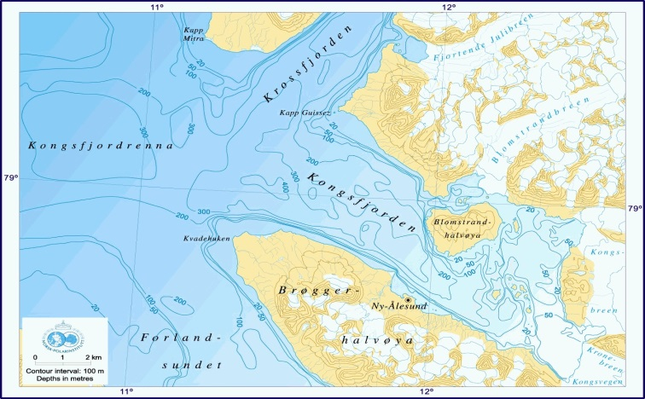
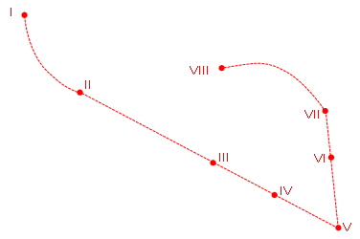
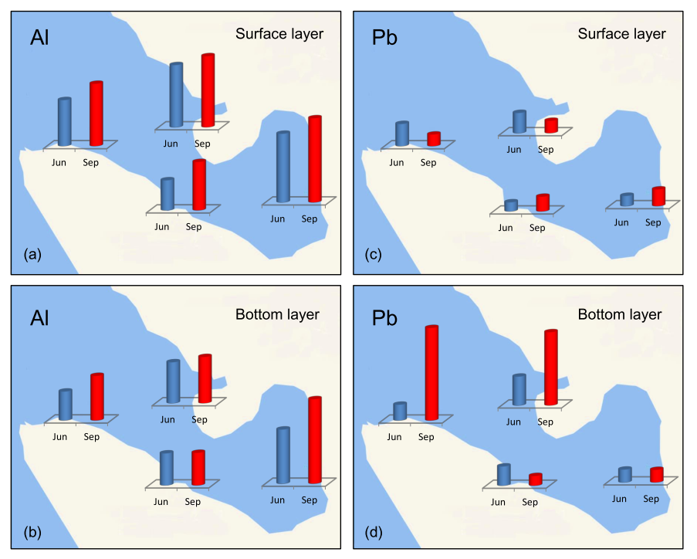
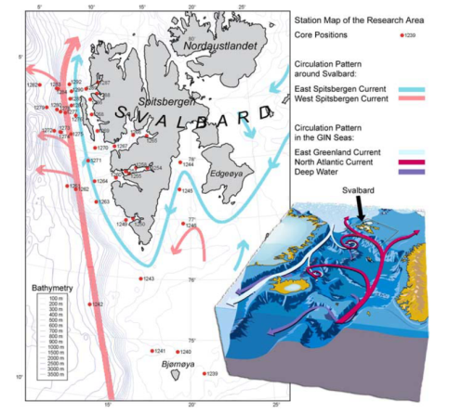
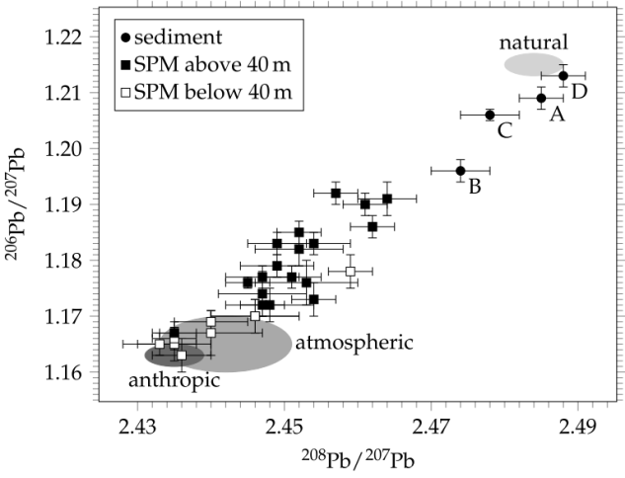
Trace metals in TSM and sediment
Repeated sampling:
Jun 2012, Sept 2012, Jul 2014, Jul 2015
Suspended particulate matter: anthropogenic input by Atlantic water for some elements (Ba, Cr, Cu, Mn, Mo, Ni, Pb, Zn), natural input by glacial runoff for others (Al, Co, Fe, K, Ti, V), both higher in summer
Sediments: negligible anthropogenic impact for trace elements (although minor enrichment for As, Cd, Cr, Ni, V), only a small percentage is bioavalaible (<5%, except for As, Cd)
B
C
A
D
Grotti et al., 2013,
Bazzano et al., 2014
Ardini et al., 2016

Slide 12
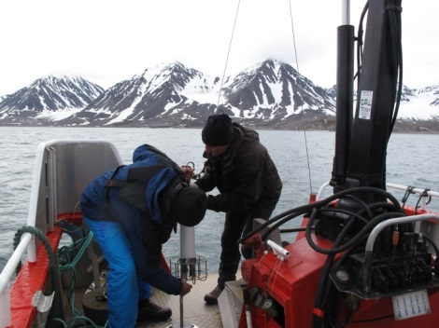
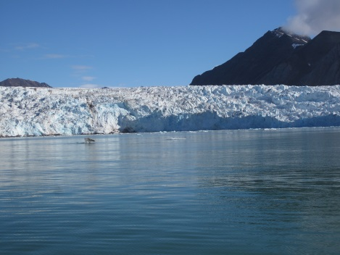
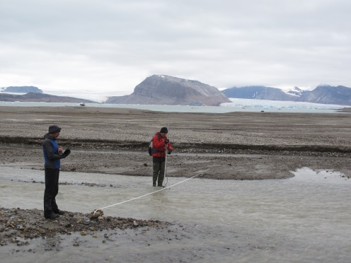
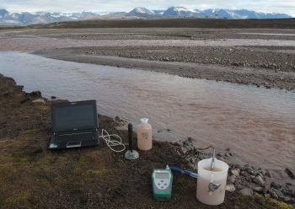
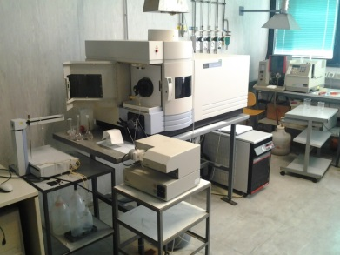
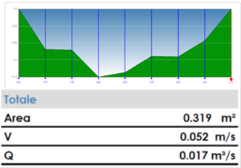
ISotopic and physical-chemical MOnitoring of GLACial drainages and sea water in the Ny-Ålesund area-Svalbard (start: June 2015)
Investigates the dynamic processes of the glacial melting (supraglacial, englacial and subglacial outputs) and evaluates the consequent transfers of fresh water towards the Kongsfjorden
Activities within Kongsfjorden
Inland activities (glacial drainages)
Physical-chemical logs and
sampling of water at defined depth
Water sampling and
physical-chemical measurements
Flow-rate
measurements
Laboratory activities (IGG Pisa)
Analysis of isotopic signatures (δ¹⁸O‰, δ²H‰, ³H and δ¹³C‰) and chemical concentrations (major and minor compounds )

Slide 13
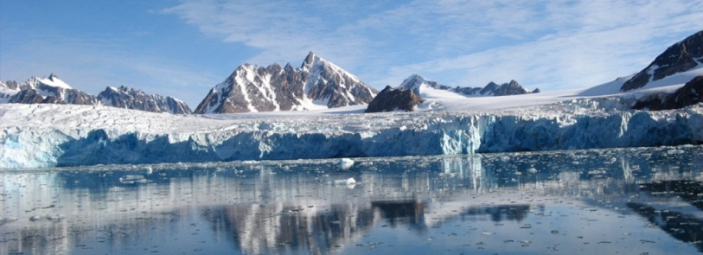

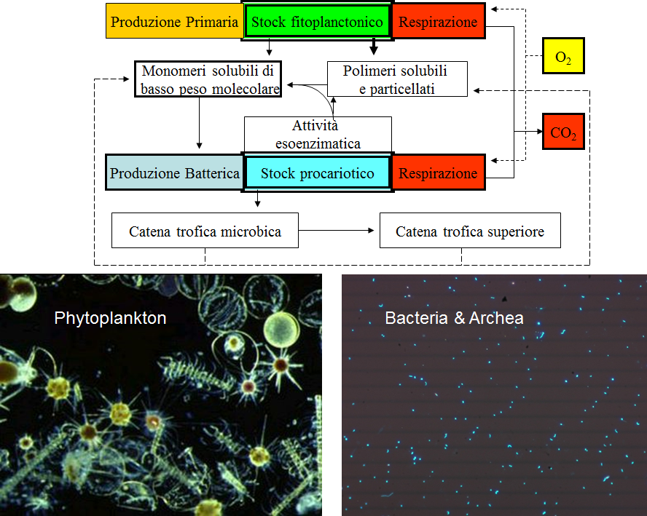
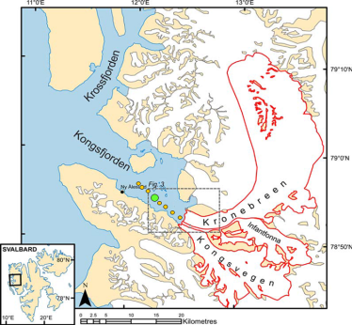
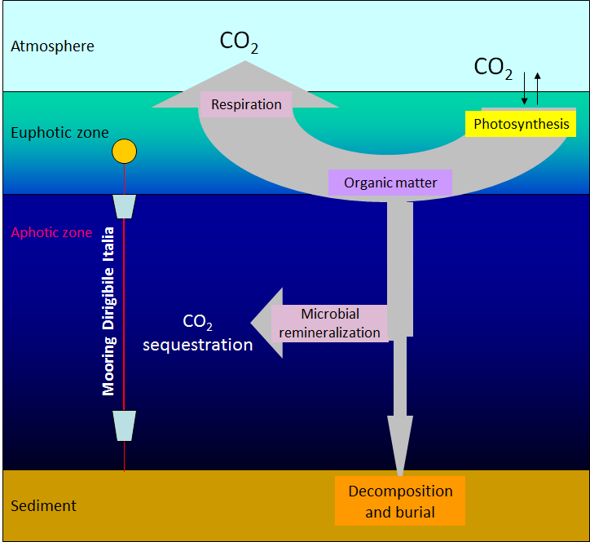
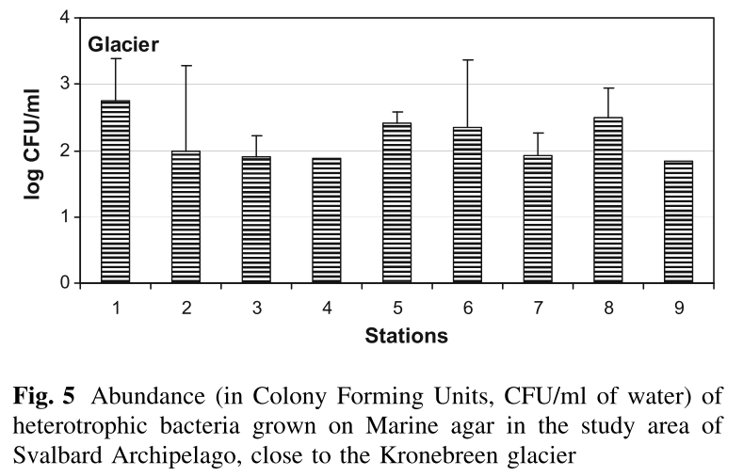
Daily variability of the microbial compartment and trophic structure at mooring site MDI
Between 10-15 m depth, layer of colder water from the glacier melting
Extinction of the solar radiation observed in the first 5 m
In such conditions, photic layer available to the phytoplankton strongly limited
Azzaro & coworkers

Slide 14
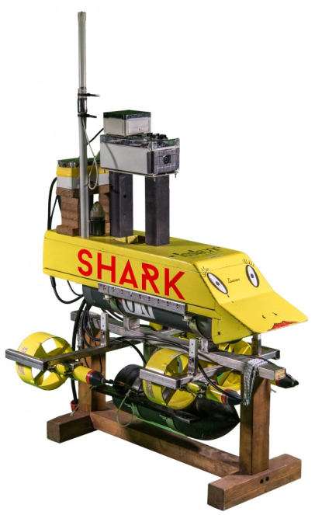





Unmanned Vehicles for Autonomous Sensing and Sampling (UVASS)
Development of integrated systems of unmanned surface vehicles (USV) for performing atmospheric, sea water and ice data sensing and water sampling
To operate and transmit data in real time in dangerous sites, such as glacier fronts, or difficult to access to human beings
Bruzzone & coworkers
Zappalà et al., 2016

Slide 15






Atmospheric observations at the Amundsen-Nobile Climate Change Tower
The 34-m- high Amundsen-Nobile Climate Change Tower (CCT) provides vertical proﬁles of meteorological parameters, since October 2009.
http://www.isac.cnr.it/~radiclim/CCTower/
7-year long time-series of radiation and energy budgets are now available
Mazzola et al., 2016

Slide 16

2 steps in the future
ARCA results are just a snapshot
Next step → need to extend monitoring activities at a decadal time scale to obtain more reliable trends and establish how climate change is affecting the Kongsfjorden System
An open question:
Are fjords able to mitigate the effects of global change by reducing gradients with respect to the adjacent ocean ?
Some observations seem to confirm it:
The increased fluvial runoff increased transfer of soil-derived OC to the fjord, and its mineralization in fjord waters could further increase the atmospheric CO₂ concentration. But fjords also behave as natural sediment traps, rapidly sequestering the terrestrial OC and thus reducing the potential negative effect
Due to very alkaline freshwater inputs, fjords can contribute to mitigate the ocean acidification, at least until the meltwater discharge will not decline

Slide 17

What needs to be done
In the project ARCA, an effort of integration between different research groups was pursued, but we still need to increase:
Coordination between different groups
Cooperation between groups of different nations
Interdisciplinarity and multidisciplinarity
Increase the sharing of infrastructures
Upgrade instrumentation, adding new sensors (new parameters, more performing)
Promote an integrated approach combining modelling and data acquisition via oceanographic cruises, autonomous stations (fixed, drifting, USV) and satellite observations
Developping a new generation of small modular aerial and marine drones able to collect data simultaneously
Tighten a strong link between Research, Innovation, Industry and SME
Make constant the flow of funds (time series are continuosly at risk of interuption)

Slide 18

Credits: CNR-DTA, CNR Arctic Base Dirigibile Italia, Kings Bay Co., projects Snow, ARCA, Hermione, Eurofleets2–Prepared & Burster, PNRA-Defrost, PRIN 2007 & 2009, bilateral Italy-Korea, AWI, Ocean Certain, ISMOGLAC ...
Thanks for your attention
photo by courtesy of Stefano Aliani

